Slide 1
Chapter 1 Tables

Slide 2
What is a table?
A table in a database is a structured collection of related data organized into rows and columns. Each table represents a single entity (such as Customer information, Students, Employees, etc), where each row represents one record and each column represents a specific attribute or field of that record.
Tables provide an organized way to store, retrieve, update, and manage data efficiently while maintaining relationships with other tables through keys.

Slide 3
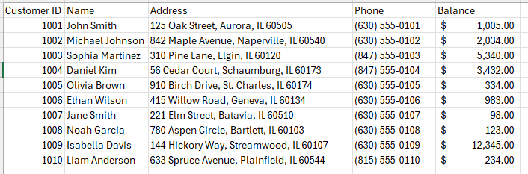
Imagine the savings account for customers. What data do you think are relevant to store for each customer?
Table
Attribute or Field
Record

Slide 4
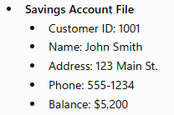
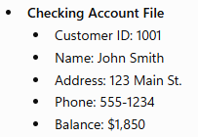
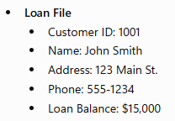
Imagine the savings, checking and loan account for customers.
Why is this a problem?
Information is duplicated across multiple files.
If John Smith moves to a new address, the bank must update every file containing his address. If one file is updated but another is not, the bank ends up with conflicting information.
Data redundancy is a situation that occurs in a database when a field needs to be updated in more than one table.

Slide 5
Suppose a customer, John Smith, has:
Savings: $5,200
Checking: $1,850
Loan: $15,000
A customer service representative wants to see all of John's accounts during a phone call. Because the information is stored in three separate files, they must:
Search the Savings Account file.
Search the Checking Account file.
Search the Loan file.
Manually combine the information.
Why is this a problem?
Since the data is isolated in different files, there is no single place where all of John's banking information is available.
Data isolation occurs when related data is stored in separate files or systems, making it difficult to access, combine, and analyze the information.

Slide 6
Suppose a customer, John Smith, changes his address from 123 Main St. to 456 Oak Ave. Because the bank uses a file-based system, his information is stored separately in the:
Savings Account File → Address updated to 456 Oak Ave. ✅
Checking Account File → Still 123 Main St. ❌
Loan File → Address updated to 456 Oak Ave. ✅
Now the bank has conflicting information about the same customer. One department may send statements to the old address while another sends them to the new address.
Why is this a problem?
This is an integrity problem because the data is no longer accurate and consistent across the system.
An integrity problem occurs when the accuracy or consistency of data is compromised, resulting in conflicting or incorrect information.

Slide 7
Suppose a bank teller's job is to process deposits and withdrawals for checking and savings accounts only. However, because the file-based system has poor access controls, the teller can also open the Loan File.
As a result, the teller can view confidential information such as:
Customers' loan balances
Credit history
Monthly loan payments
Why is this a problem?
Even though this information is unrelated to the teller's job, they still have access to it.
A security problem occurs when unauthorized users are able to access, view, modify, or delete data they should not have permission to access.

Slide 8
Suppose John Smith has $5,000 in his checking account.
At the same time:
A bank teller is processing a $1,000 cash withdrawal.
An ATM is processing a $500 withdrawal from the same checking account.
Both transactions read the balance before either one updates it.
The teller reads the balance: $5,000.
The ATM also reads the balance: $5,000.
The teller subtracts $1,000 and saves the new balance: $4,000.
The ATM subtracts $500 from the balance it originally read ($5,000) and saves $4,500.
The final balance becomes $4,500, when it should be $3,500.
This happened because both transactions accessed and updated the same account simultaneously, causing one update to overwrite the other.
A concurrency problem occurs when two or more users or transactions access and modify the same data at the same time, resulting in incorrect or inconsistent data.

Slide 9
So, to summarize, the issues with maintaining a file-based system are:
Data redundancy- is a situation that occurs in a database when a field needs to be updated in more than one table.
Data isolation - occurs when related data is stored in separate files or systems, making it difficult to access, combine, and analyze the information.
Integrity problem - occurs when the accuracy or consistency of data is compromised, resulting in conflicting or incorrect information.
Security problem - occurs when unauthorized users are able to access, view, modify, or delete data they should not have permission to access.
Concurrency problem - occurs when two or more users or transactions access and modify the same data at the same time, resulting in incorrect or inconsistent data.

